Slide 1
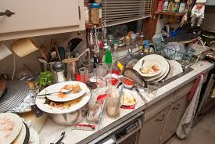
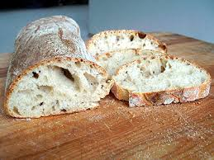
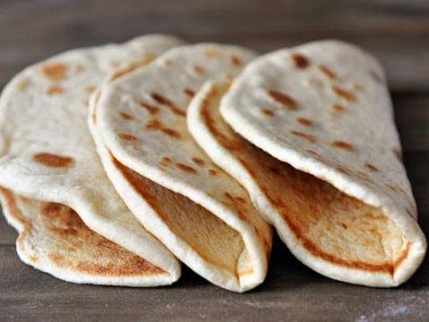
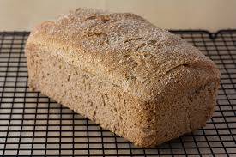
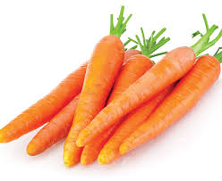
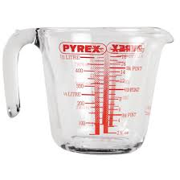
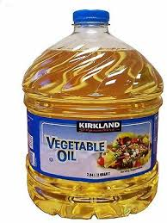
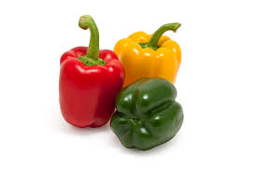
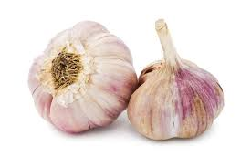
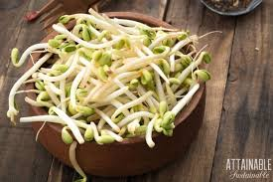
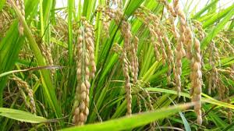
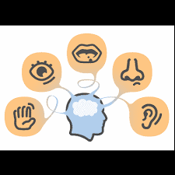
DEEPER LEARNING rice
WHY BREAKFAST ?
ALWAYS REMEMBER food safety
YEAR 8 KNOWLEDGE ORGANISER
STAPLE FOODS - BREAD
Food safety is essential in the kitchen to prevent food poisoning , therefore one must never forget the Four C's - cleaning, cooking, chilling and cross contamination to protect your family against deadly germs.
When is frying healthy?
Bread is made from flour, salt, water and if yeast is used the bread will be risen and soft. Bread is often made from wheat flour, but other grains, such as corn and rye can also be used. Originally, flour was made by crushing wheat grains between stones but now machines are used. Wholemeal bread is healthy and uses the whole grain. Different countries from around the world eat different types of bread
When food is cooked well properly, germs which cause food poisoning are killed. It is a must to cook meat poultry, fish and eggs very well. Incorrect food storage and unclean dishes are also a common cause of food poisoning
"Rice field" or paddy fields are used to grow rice and are flooded parcels of arable land used for rice and is found in countries which have large amounts of rainfall due to monsoon conditions so the fields can flood easily.
SENSORY TESTING
KEY VOCABULARY
Heat transfer
Conduction
Convection
Radiation
Dough
Raising agent
Leavened
Wholemeal
Culture
Sensory properties
Sustainability
Added sugar
KEY VOCABULARY
Aesthetic
Texture
Aroma
Flavour
Sweet
Savoury
Evaluate
All forms of paddy rice have been cultivated from wild rice that first occurred 8,200–13,500 years ago South of the Yangtze River in China. Paddy fields are the typical feature of rice farming in east, south and southeast Asia. Fields can be built into steep hillsides as terraces and adjacent to depressed or steeply sloped features such as rivers or marshes. They can require a great deal of labour and materials to create, and need large quantities of water for irrigation. Oxen and water buffalo, adapted for life in wetlands, are important working animals used extensively in paddy field farming. Rice is a sustainable crop.

Slide 2
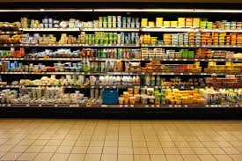
Week 7 shopping
YEAR 8 KNOWLEDGE ORGANISER
Week 1 Write a list of safety points used in a kitchen to avoid food poisoning
Week 2 Name 4 of bread and explain where each originates
Week 3 Find out what the 3R’s are. How do they relate to food packaging
Week 4 Use a recipe book to find 6 rice dishes 2 must be sweet and 4 can be savoury
Week 5 Find the definition of a healthy diet the find out 5 main nutrients Explain why
protein is essential for our bodies
Week 6 Write a paragraph which includes what has gone well in Food Technology and
explain why. Suggest an area where you could improve and explain how you could do this
Week 7 Visit a supermarket and find 10 foods which are stored in the fridge section

