Slide 1
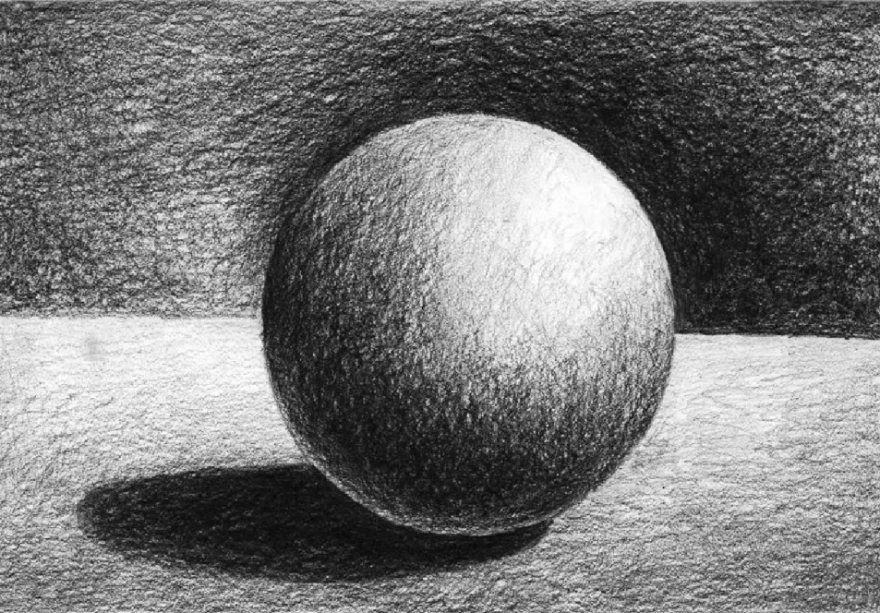
Key Vocabulary…
Picture This…
Deeper Learning…
OBSERVATIONAL DRAWING | Drawing from looking at an image or object.
PRIMARY OBSERVATION | Drawing from an object that is directly in front of you.
SECONDARY OBSERVATION | Drawing from an image.
PHOTOGRAPHS | Using a camera to record images – this is classed as primary observation.
SKETCHES | Basic sketches and doodles can act as a starting point to aid in developing an idea.
ANNOTATION: -
STEP 1: DESCRIBE
What is this an image of?
What have you done?
What was the purpose of the piece?
STEP 2: EXPLAIN
How was the work made?
How did you produce the effect?
How did you decide on composition?
STEP 3: REFLECT
Why did you use this specific method?
Why are some areas better than others?
What might you do differently next time?
Why might you do it differently?
How will your develop in response?
KS4: AO3 – RECORD: observations and insights into intention.
Always remember…
CROSS-HATCHING | Cross-hatching uses fine parallel lines drawn closely together to create the illusion of shade or texture in a drawing. It is the drawing of two layers of hatching at right-angles to create a mesh-like pattern.
HATCHING | For pencil or pen-and-ink drawing. Hatching is one of the quickest ways to fill in the dark areas. By drawing a lot of fine lines that are parallel, the area as a whole is perceived as being darker.
STIPPLING | The art or process of drawing, painting, or engraving using numerous small dots or specks.
The Big Question…
NEXT STEPS: -
Produce a range of tones by varying the pressure and layering
Consider using softer pencils for darker shades
Apply tone using a soft circular motion to create a smooth coverage. Filling all the white gaps and avoid shading in different directions
Add detail/interest by applying tone using mark-making techniques
Mark-making can be produced by making your own tools/paintbrushes
Activity: Try to annotate or evaluate whenever you have an idea or a change in direction. Write about a technique that was successful or if something didn’t go as planned.

