Slide 1
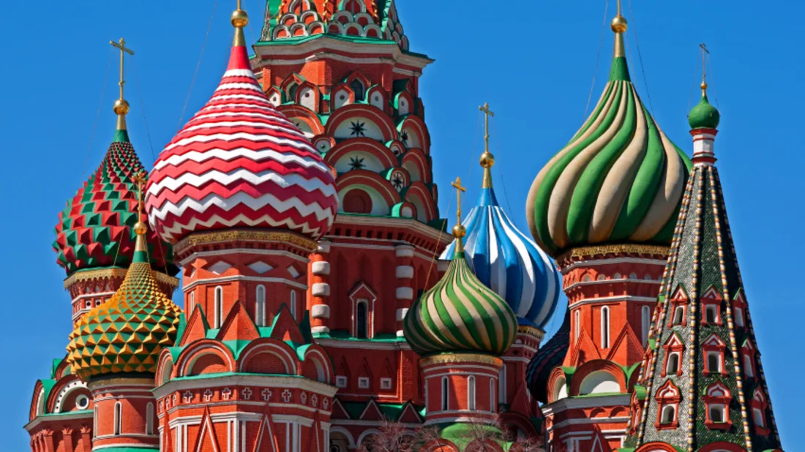
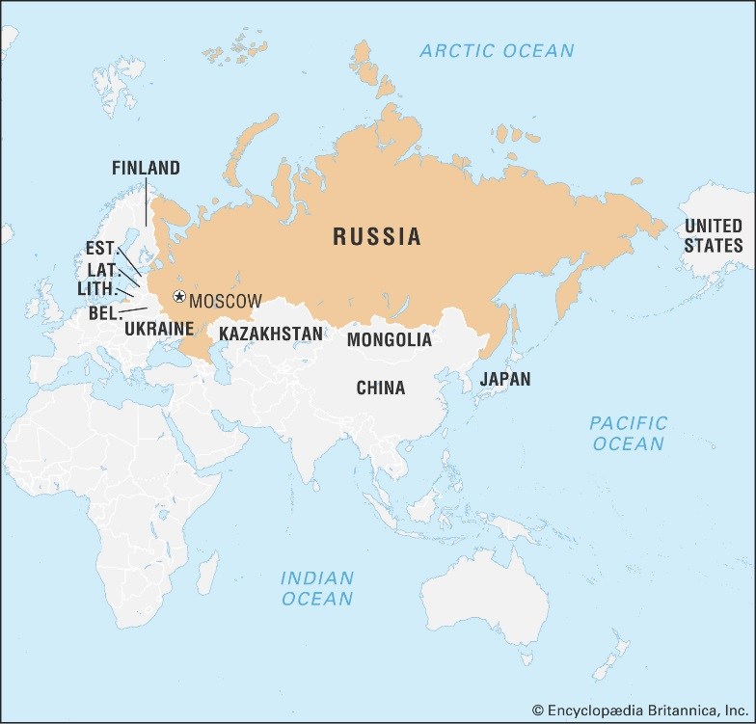
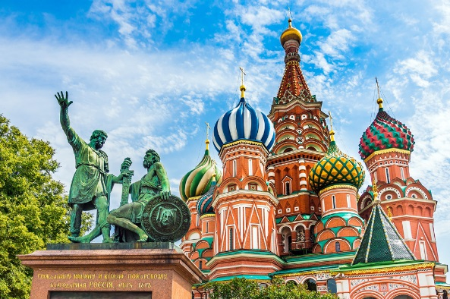
Key Vocabulary…
Picture This…
Deeper Learning…
ARCHITECTURE | A term to describe buildings and other structures. The art and style of design and method of construction of buildings and other physical structures.
ST. BASIL’S CATHEDRAL | is a church in Red Square in Moscow, Russia and is regarded as a symbol of the country.
WHAT IS RUSSIAN ARCHITECTURE?
Russian architecture has long been known for its distinctive style. While most of the country's iconic buildings as we known them were constructed in the 1870s-1890s, there are some later outstanding examples, too.
Wood was probably the most popular construction material in traditional Russian architecture. Building in huge territories surrounded by forests, this was the best choice for houses, churches, and town walls. The material was often carved into different shapes and coloured to add decorative elements to the buildings.
Always remember…
Y8 KNOWLEDGE ORGANISER: Russian Architecture.
NARROW WINDOWS | Another element very often seen in Russian buildings, narrow windows in this instance are also quite tall.
DISTINCTIVE BRICKWORK AND DECORATIVE FACADES | For some years, in 19th century, brick architecture became linked with Russian style architecture.
MULTIPLE ARCHES | Arches are everywhere in Russian architecture, from windows to doors and the ceiling to look like the sky from inside the building.
STAINED-GLASS WINDOWS | Stained-glass windows in which small pieces of glass are arranged to form patterns or visual imagery, held together (traditionally) by strips of lead and supported by a frame and painted to enhance details.
St. Basil’s Cathedral
The Big Question…
Tint.
NEXT STEPS:
How could you create your own piece of architecture?
What material could you use to recreate the grandeur of St. Basil’s Cathedral?
Activity: Make a list of what you think the dome or Terem roof looks like? Thinks about everyday objects i.e. sweets?

