Slide 1
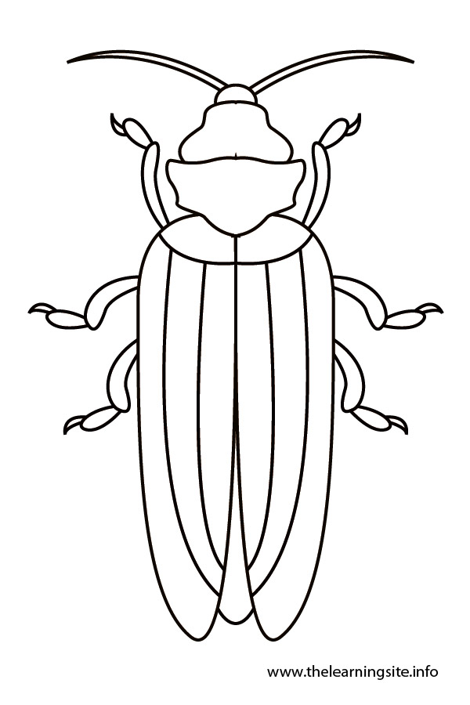
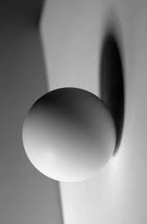
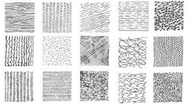
Key Vocabulary…
Picture This…
Deeper Learning…
LINES | Marks made on a surface, they have a beginning and an end.
FORM | The use of lines to create something else.
TONE | How light and dark you press with a pencil or pen to create depth.
THE 7 FORMAL ELEMENTS OF ART: -
We will spend this term focusing on line and tone and exploring artists that link to using line and tone within their work. By changing the pressure of your pencil or adding a variety of textures - you can create a 3-Dimensional effect.
The Formal Elements are the parts used to make a piece of artwork. The seven formal elements of art are line, shape + form, space, value, texture, pattern and colour.
They are often used together, and how they are organised in a piece of art determines what the finished piece will look like.
Always remember…
Y7 KNOWLEDGE ORGANISER: Line and Tone.
OBSERVATIONAL DRAWING | Drawing from observation is drawing what you can see, not what you know. There will be an object placed on the table and you will draw from the angle that you can see.
TONAL SCALE | Tonal scales are ways on exploring tonal values. It is a common exercise in art to be asked to create a tonal scale.
MARK-MAKING | Mark making is a term used for the creation of different patterns, lines and textures.
SYMMETRY | Symmetrical means having two sides or halves that are the same.
The Big Question…
NEXT STEPS:
What is a line?
What is tone?
What is symmetry?
How can we use line to create texture?
Activity: Using the template provided or creating your own animal outline, Fill will Zentangle patterns and try to create depth by using lots of small clustered lines to create dark areas and lots of space between lines to create lighter areas.

