Slide 1
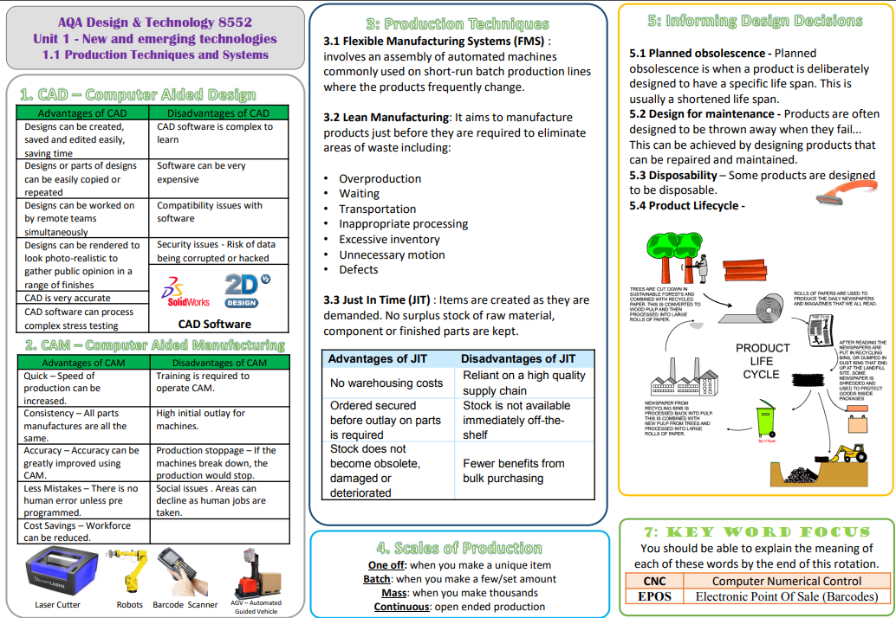
GCSE Design & Technology
New & Emerging Technologies

Slide 3
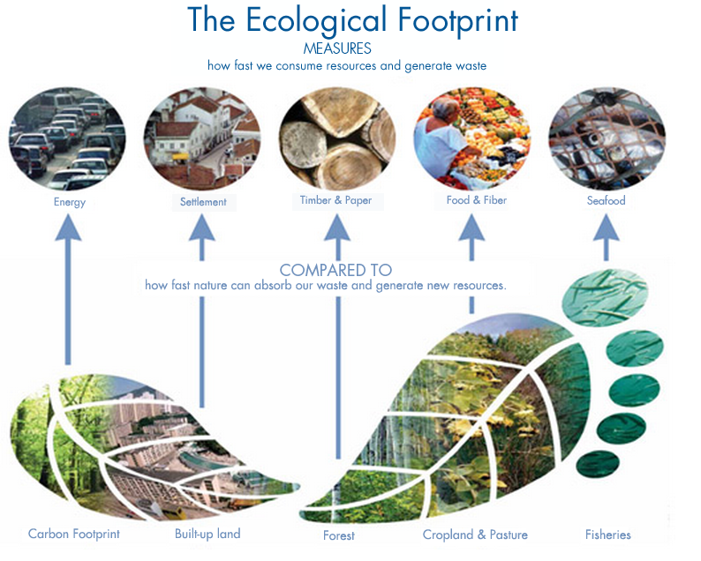
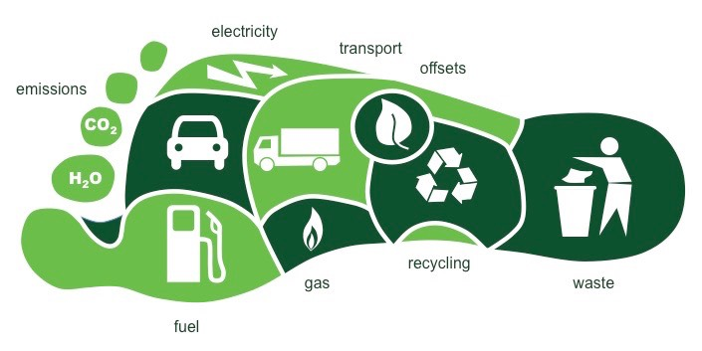
GCSE Design & Technology
New & Emerging Technologies
The ecological footprint measures human demand on nature
Ecological Footprint
The ecological footprint measures human demand on nature. it is a measure of human’s impact on Earth’s ecosystem and reveals the dependence of the human economy on natural capital..
Social, Moral, Environmental and Sustainability issues.
Social
We are all part of one world and we do rely upon each other. Any thing we can do to promote positive work or play is good however as designers we also have a responsibility to make sure designs don't have a negative impact. Products can really influence us as people and as designers we need to be positive role models encouraging 'Social Harmony'.
Moral
As a designer you have a moral responsibility to do the right thing. Moral issues is about being fair and honest. You should be thinking about what is 'right' for the consumer. For example a moral designer should be considering the safety of potential users as a high priority as well as making sure they don't feel uncomfortable or come to any harm. People with strong morals are honest and decent and will put other people before their own personal gain.
Environmental & Sustainability
When developing designs you need to think about environment and sustainability issues as we only have one planet and need to make sure we look after it. -The materials will have an impact of some kind -using materials that can be easily recycled is a good start - locally sourced uses less fuel - open cast mines and deforestation have negative impact Energy consumption is also important. A lot of energy comes from fossil fuels so needs to be reduced. An efficient making process uses less electricity and relies less on fossil fuels.
Carbon Footprint
Sustainable living is a lifestyle that attempts to reduce an individual's or society's use of the Earth's natural resources and personal resources. Practitioners of sustainable living often attempt to reduce their carbon footprint by altering methods of transportation, energy consumption, and diet.
Fairtrade
Fair trade is an institutional arrangement designed to help producers in developing countries achieve better trading conditions. Members of the fair trade movement advocate the payment of higher prices to exporters, as well as improved social and environmental standards

Slide 4
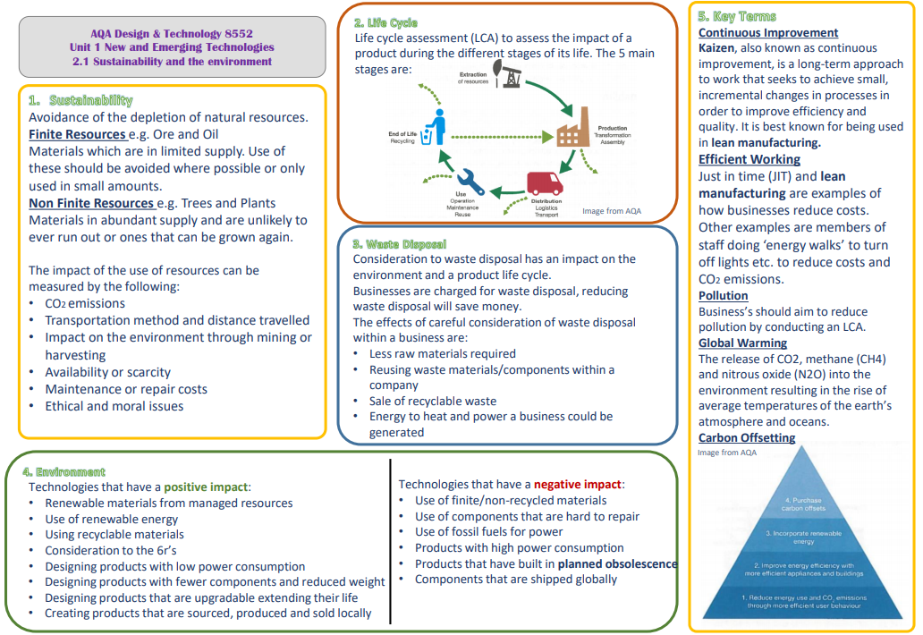
GCSE Design & Technology
Sustainability

Slide 5
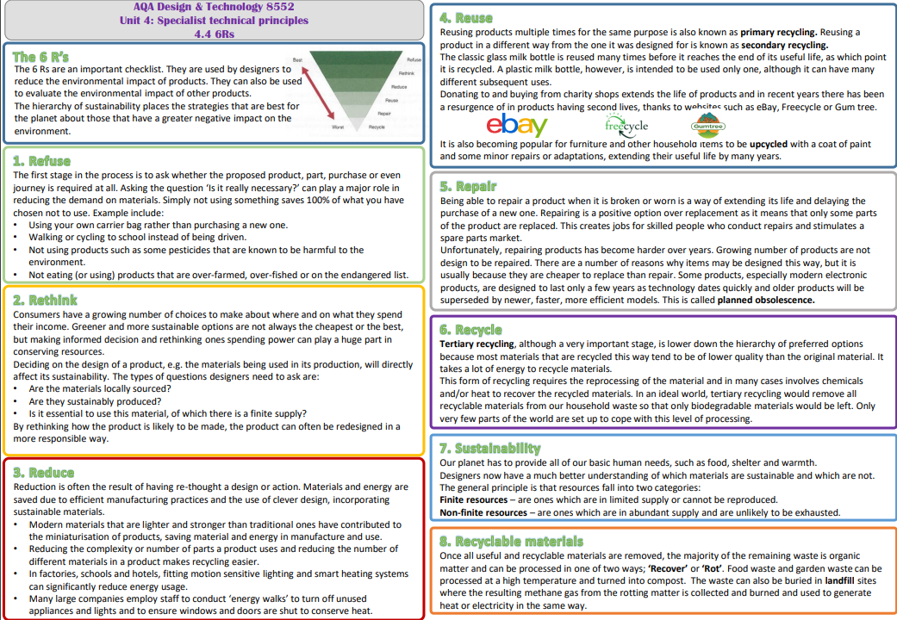
GCSE Design & Technology
Sustainability

Slide 6
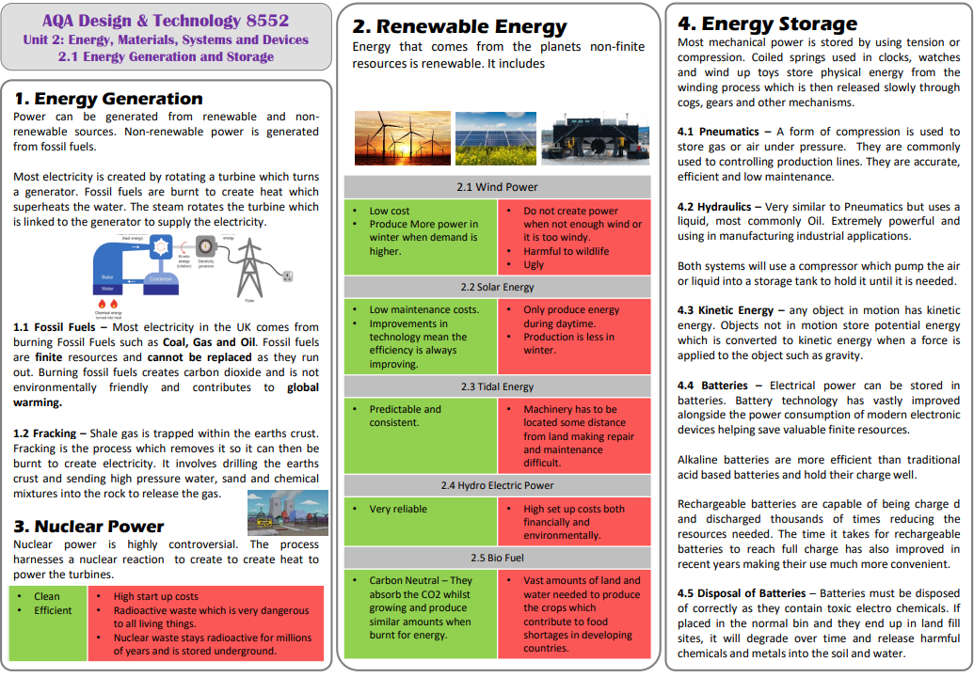
GCSE Design & Technology
Energy Generation & Energy Storage

Slide 7
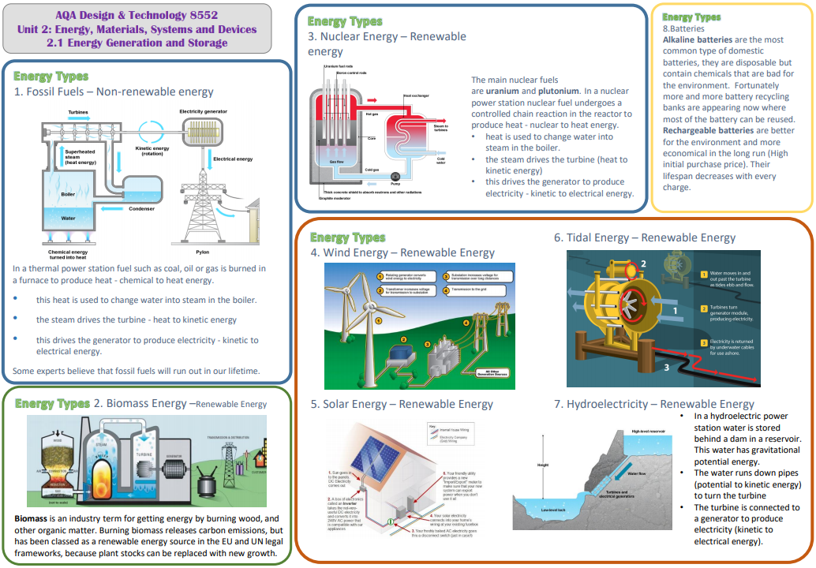
GCSE Design & Technology
Energy Types

Slide 8
GCSE Design & Technology
Electronic Components

Slide 9
GCSE Design & Technology
Microcontrollers

Slide 10
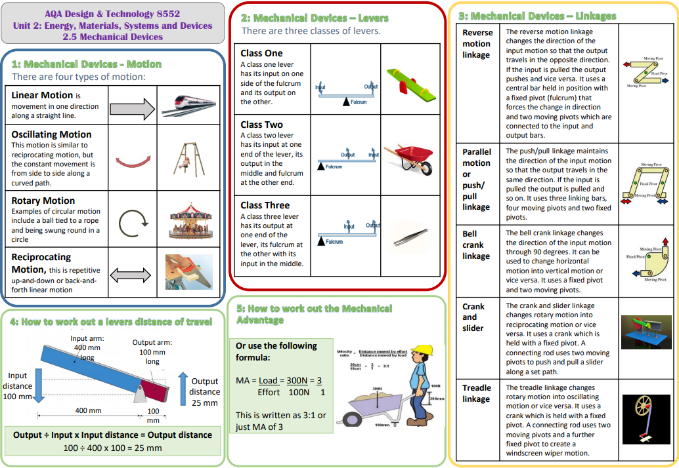
GCSE Design & Technology
Mechanical Devises

