Slide 1
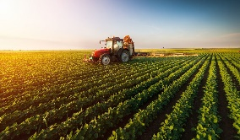
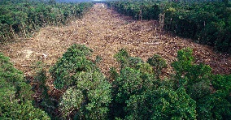
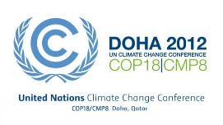
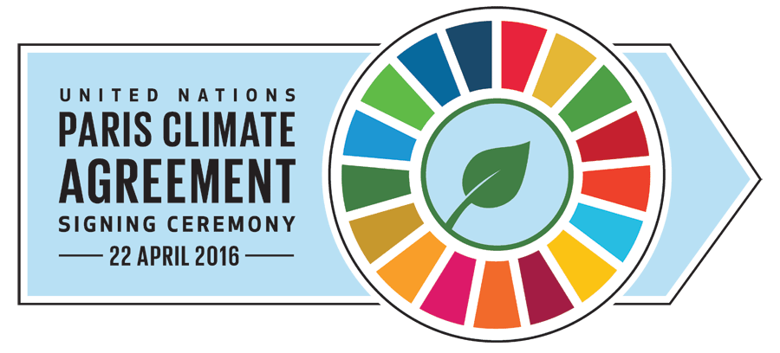
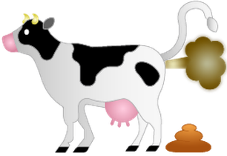
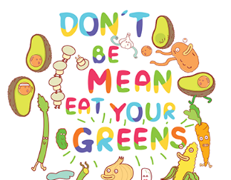
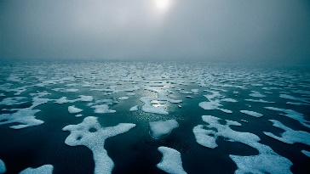
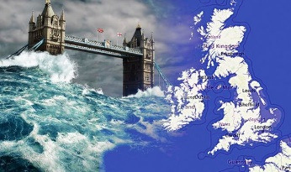
Key Vocabulary…
Key summits…
Picture this…
Climate | Climate means the usual condition of the temperature, humidity, atmospheric pressure, wind, rainfall, and other meteorological elements in an area of the Earth's surface for a long time. In simple terms climate is the average condition for about thirty years.
Natural causes | These are natural occurring, NOT influenced by humans. For example, Orbital changes, Volcanic activity and Solar output
Human causes | These are causes influenced by human activity for example, Burning fossil fuels, deforestation, dumping waste in landfill and agriculture.
Impacts | Impacts can be social (people), economic (money or environmental. It is how climate change effects us and our surroundings
Sustainable management | Sustainable management means ensuring that it is a sustained in a way for future generations to use. Sustainable management also involves making sure local people are not disadvantaged, and ensuring that management is environmentally friendly.
Electrical Components
Agriculture
Deforestation
Kyoto Protocol |  | The Kyoto Protocol was adopted on 11 December 1997. It is an international treaty among industrialized nations that sets mandatory limits on greenhouse gas emissions.
Doha Amendment |  | The Doha Amendment refers to the changes made to the Kyoto Protocol in 2012. he Amendment adds new emission reduction targets for Second Commitment Period (2012-2020) for participating countries.
Paris Agreement |  | The Paris Agreement is a pact within the United Nations Framework Convention on Climate Change (UNFCCC) between 197 countries that focuses widely on reducing greenhouse gases emissions, adapting to the impacts of climate change, and to provide financial assistance to developing countries affected by a changing climate.
Tools & Equipment
The BIG questions..
Explain the social, economic and environmental impacts of climate change
Do you think climate change is a more natural or human cause? Discus your answer
Geography: Year 9 - Climate Change
Deeper Learning…
Did you know..?
Everywhere on Earth ice is changing. The famed snows of Kilimanjaro have melted more than 80 percent since 1912. Glaciers in the Garhwal Himalaya in India are retreating so fast that researchers believe that most central and eastern Himalayan glaciers could virtually disappear by 2035. Arctic sea ice has thinned significantly over the past half century, and its extent has declined by about 10 percent in the past 30 years. NASA's repeated laser altimeter readings show the edges of Greenland's ice sheet shrinking. Spring freshwater ice breakup in the Northern Hemisphere now occurs nine days earlier than it did 150 years ago, and autumn freeze-up ten days later. Thawing permafrost has caused the ground to subside more than 15 feet (4.6 meters) in parts of Alaska. From the Arctic to Peru, from Switzerland to the equatorial glaciers of Man Jaya in Indonesia, massive ice fields, monstrous glaciers, and sea ice are disappearing, fast.
Methane is a greenhouse gas and it is produced by cows. In fact methane enters our atmosphere when a cow passes wind! Due to our growing population and more people than ever eating meat, we need more cows to feed everyone; therefore more methane in out atmosphere. Scientists believe by eating just one meat free meal a week can help reduce the effects of climate change on our planet!
Sea levels will rise…
According to an IPCC report, parts of London could be submerged if the sea levels rise by more than two metres. Coastal and low-lying areas will be the affected the most, meaning large areas of the North East could also disappear if ice caps melt.
Activity: You live on a coastal town effected by rising sea levels in the UK. Write a letter to your local MP informing them of the impacts (S,E,EN) and what management strategies they should put in place to help your community.

