Slide 1
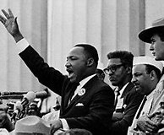
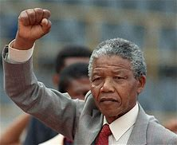
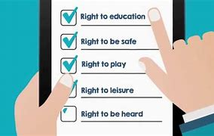
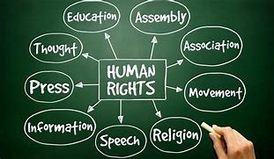
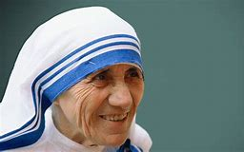
Key Vocabulary…
Key People
Always Remember…
Human Rights | A right which belongs to every person. The Universal Declaration of Human Rights was issued in 1948 – it set out basic rights that every human being was entitled to such as FREEDOM, SHELTER, SAFETY, NOT TO BE A SLAVE and EDUCATION.
Social Justice | A fair distribution of wealth and opportunities such as housing and education.
Wealth | Financial assets (things) that can be used in a transaction (bought and sold). These can include property, raw materials and money.
Poverty | The state of being extremely poor and not having enough basic things that a person needs (This can include education)
Prejudice | Feeling towards another person or group that is not based on evidence but pre-conceived (ideas and thoughts that are already there) feelings.
Discrimination | Unfair treatment of people or groups based on gender, sexuality, race, religion and skin colour.
Electrical Components
 | One of the best-known Christian leaders who fought against racial prejudice and discrimination was Martin Luther King Jr, an American clergyman, activist, and leader in the African-American Civil Rights Movement. ‘Love your enemies and pray for those who persecute you.’ (Matthew 5:44)
Nelson Mandela was a tireless campaigner for equality and justice who spent 27 years in prison for his beliefs. In 1994 he became the first president of South Africa to be elected by all the people, black as well as white. He worked to take end the old racist system (apartheid) of government and to make South Africa a fairer society for all its citizens.
 | Mother Teresa was a Roman Catholic nun who believed God called her to work with the poor and dying in Calcutta (the capital of the Indian state of West Bengal). Her example helps people experience God’s love and care for the poor and encourages others to do the same
Tools & Equipment
When we look at Christian Ethics we are looking at how Christian values such as PEACE, LOVE and RESPECT are applied in the ‘real world’
Religious Studies – Y8 – Ethics
UNCHR + UNCRC
UNCHR
The Universal Declaration of Human Rights (UDHR) is a milestone document in the history of human rights. Drafted by representatives with different legal and cultural backgrounds from all regions of the world, the Declaration was proclaimed by the United Nations General Assembly in Paris on 10 December 1948 (General Assembly resolution 217 A) as a common standard of achievements for all peoples and all nations. It sets out, for the first time, fundamental human rights to be universally protected and it has been translated into over 500 languages.
UNCRC
The United Nations Convention on the Rights of the Child (commonly abbreviated as the CRC or UNCRC) is a human rights treaty which sets out the civil, political, economic, social, health and cultural rights of children.
What is a ‘Living Wage’?
Living wage refers to a wage level that allows an individual to afford adequate shelter, food and the other necessities. A living wage should be substantial enough to ensure that no more than 30% of it gets spent on housing. Finland has started paying a basic income of €560 a month to randomly selected unemployed people. Finland has become the first country in Europe to pay its unemployed citizens a monthly wage, in a social experiment that will be watched around the world amid gathering interest in the idea of a universal (for everyone in the world) basic income.
In the Parable of the Good Samaritan, Jesus uses the example of the Jew and the Samaritan, who would not ordinarily have been friendly towards each other. However, out of all those who could have helped the Jew, only the Samaritan did. Jesus tells of a man who was travelling from Jerusalem to Jericho and was attacked by robbers on the way. He was badly beaten and left for dead.
The first person to pass the injured man was a priest, who crossed the road and continued walking.
The second person to pass the injured man was a Levite, a priest’s assistant. He also crossed the road and continued walking without helping the man.
The third person to come by was a Samaritan, a person from Samaria. The Samaritans were hated by the Jews. When the Samaritan saw the man, he took pity on him. He bandaged him and cleaned his wounds. He then put him on the back of his donkey and took him to an innkeeper, whom he paid to look after him.
The parable ends with Jesus giving a commandment to go out and do the same as the Samaritan had done. The key message was that you should ‘Love thy Neighbour’. Jesus defined any other person as a neighbour
Activity – Everybody in the U.K should be given a living wage of £12,000 a year. (a person in work would have their wage added to this but there would be no benefit system). How far do you agree with this statement? Write an essay arguing FOR and AGAINST this statement with your own conclusion at the end.

