Slide 1
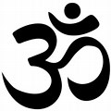
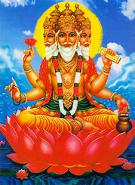
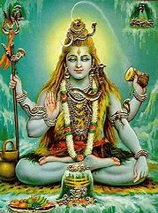
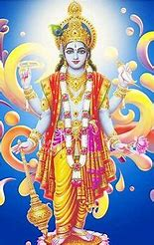
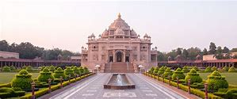
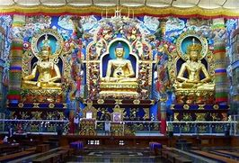
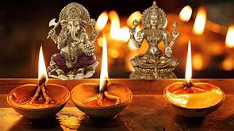
Key Vocabulary…
Picture This…Trimurti (3 aspects of Brahman)
Always Remember…
Om/Aum | Symbol of the religion of Hinduism. It is said at the beginning and end of all prayers
Brahman | Hindus believe in One Supreme Spirit, or Power called Brahman. Brahman can take the form of many gods and goddesses, also known as deities.
Trimurti | Hindus believe that Brahman is beyond their understanding, so the different gods and goddesses help them to understand various aspects of Brahman. Three of the Hindu gods are known as the Trimurti (Brahma, Vishnu, Shiva)>>
Mandir | Hindu Temple
Puja | Hindu Worship
Ahimsa | Many Hindus are vegetarian because they live by a principle called ahimsa, which means not harming any living creature. Hindus believe cows are especially holy so many Hindus avoid eating or harming them.
Murtis | Different forms of Brahman.
Divali/Diwali | The main Hindu festival – The festival of lights.
Ramayana | An epic poem telling the story of Hindu deities, Rama and Sita. Their safe return, led by lights or lamps, is the reason that Diwali is celebrated.
4 stages of life | The Four Stages of Life in the Hindu faith are the outline of the ideal lifestyle and bring you one step closer to achieving Moksha (Freedom the cycle of re-birth and death). The four stages are Student, Householder, Forest Dweller and Wandering Ascetic stage
Electrical Components
Brahma (The Creator) | Vishnu (The Preserver) | Shiva (The Destroyer)
Hinduism is the name of the religion, and its followers are known as Hindus.
Hinduism is the oldest of the six major world religions. It has no single founder but developed gradually over a period of time.
Hinduism has over 1 billion followers worldwide, with about 95% of Hindus living in India. At the time of the 2011 census, there were over 800,000 Hindus living in the UK.
Tools & Equipment
Religious Studies – Year 7 - Hinduism
Mandir
A Hindu temple is a symbolic house, seat and body of the Gods. It is a structure designed to bring human beings and Gods together.
Festival – Divali/Diwali
Diwali celebrates the Ramayana, which is an epic poem telling the story of Hindu deities, Rama and Sita. In the story, Rama is sent away to a far-off country by his father. Rama leaves with his wife, Sita, but Sita gets kidnapped by a wicked demon called Ravana. The monkey god, Hanuman, helps Rama save Sita and kill Ravana so they can finally return home. This story is about good overcoming evil. Lamps were lit to guide Rama and Sita home, and this is why most Hindus light diya lamps during Diwali today.
Hindus also celebrate Diwali to honour the goddess Lakshmi, the Hindu goddess of fortune. Most Hindus believe that if their house is clean and there are diya lamps to light the way, then she will visit their home, bringing good fortune for the coming year. During Diwali, the mandir is also decorated with lights and murtis (images or statues of the Hindu gods or goddesses) are dressed in new clothes and offered food. Hindus believe Lakshmi will bless the food (prasad), which will be shared out amongst the community.
How is Diwali celebrated?
Diwali brings Hindu communities together, to celebrate light overcoming darkness and good defeating evil. Many Hindus celebrate at home and in the mandir by giving presents to each other, sharing meals, singing, dancing and going to firework displays. It is also a time to thank Lakshmi for everything they have. Many Hindus do this by giving money and food to the poor, and this is called dana. >>>>>>>>>>>>>>>>>>>>>>>>>>>>>>>>>>>>>>>>>>>>>>>>>>>>>>>>>
Hindu Worship - Puja
Hindu worship is called puja. Hindus can worship at their holy building, called a mandir, or in their home. Puja involves praying to a favourite god or goddess. A statue or image is often used as a focus, and these are sometimes called murtis (meaning forms). During puja offerings of fruit and sweet foods are made to the deity (God/Goddess).
Hindus have a lot of holy books. The authors are called the Vedas and the Upanishads, and they're mostly used by priests, but there are some like the Ramayana and Bhagavad Gita, which a lot of Hindus read for themselves.
Activity – Research in more detail a MANDIR. Draw and label a diagram or picture of a Mandir. Focus on the key elements inside a Mandir.

