Slide 1
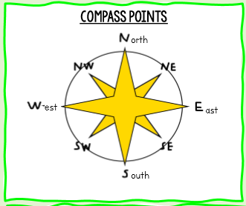
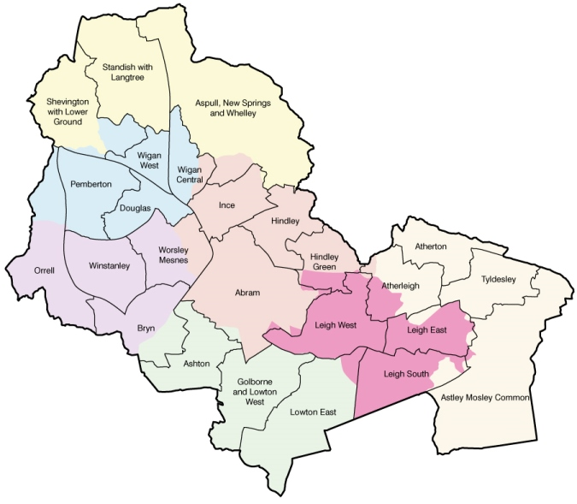
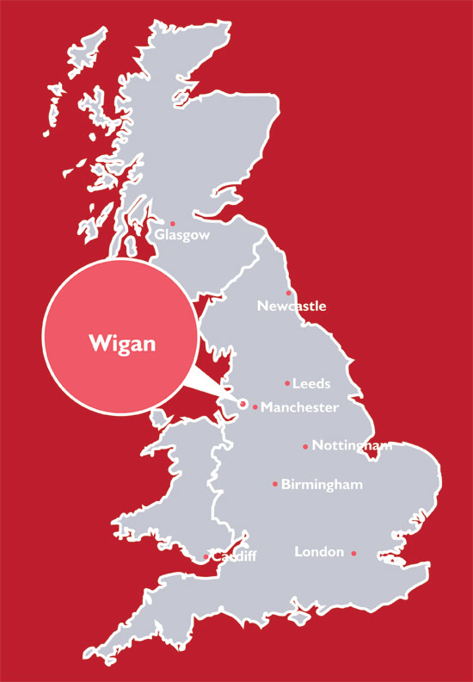
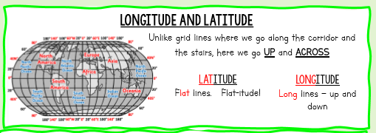
Key Vocabulary…
Compass Directions | Can be 4, 8 or 16-point. The most basic form being North, East, South and West.
Contrast | 2 things that are different to each other e.g. a town and the countryside
Distance | The length of the space between two points, usually measured in metres, kilometres or miles.
Vegetation | Trees, Plants, Grass, Shrubbery, Forests
Human Uses | How people use an area or landscape.
Issue | An important topic or problem for debate or discussion.
Population | The people who live in a place, often given as a number. Tokyo in Japan is the city with the highest population in the world.
Map | A diagrammatic representation of an area of land or sea showing physical features, cities, roads, etc.
Location of Wigan
Areas of Wigan
Electrical Components
Tools & Equipment
Geography examines issues on different scales. Some affect the world and are Global issues. Some may affect a whole country and are National Issues. Some will just affect a town or village and are Local Issues.
Subject: Geography : Yr7 Topic: Making Connections
Geography is the study of Earth’s landscapes, peoples, places and environments. It is, quite simply, about the world in which we live.
Human geography is the study of the many cultural features found throughout the world. It looks at how they relate to the spaces and places where they originate and how they can travel as people continually move across various areas.
Diversity means that there are lots of different kinds of things.
Just as there are lots of different makes of cars, bikes, clothes or just about anything you can think of. Places are diverse also.
Diversity is not just about the way things look. Where we are in the world can make for a great deal of diversity too.
Homework Activity…
As well as completing a map activity, you will be assigned a country and will need to create a study project on it. This can be as a booklet, poster, video – you choose how to present the information. You need to include lots of key pieces of information –Location, size, population, climate, major cities, culture, food, landmarks as well as loads of interesting facts about the country. This is your chance to create a piece of work to go on display in the school and even feature on the schools Twitter page.
Physical geography is the study of the natural features of the earth's surface, this includes land formation, climate, currents, and distribution of natural world (wildlife and vegetation).

