Slide 1
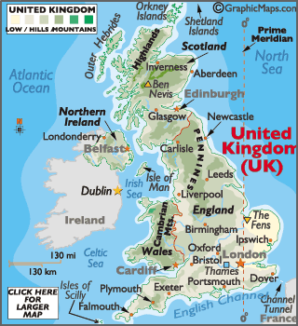
“Suggest how the UK benefits economically and politically from its membership from the commonwealth”
Case Study: Economic Change in the UK
UK in the Wider World
The UK has one of the largest economies in the world. The UK has huge political, economic and cultural influences. The UK is highly regarded for its fairness and tolerance. The UK has global transport links i.e. Heathrow and the Eurostar.
Causes of Economic Change | Towards Post-Industrial
De-industrialisation and the decline of the UK’s industrial base. Globalisation has meant many industries have moved overseas, where labour costs are lower. Government investing in supporting vital businesses. | The quaternary industry has increased, whilst secondary has decreased. Numbers in primary and tertiary industry has stayed the steady. Big increase in professional and technical jobs.
Developments of Science Parks | CS: UK Car Industry
Science Parks are groups of scientific and technical knowledge based businesses on a single site. Access to transport routes. Highly educated workers. Staff benefit from attractive working conditions. Attracts clusters of related high-tech businesses. | Every year the UK makes 1.5 million cars. These factories are owned by large TNCs. i.e. Nissan. 7% of energy used there factories is from wind energy. New cars are more energy efficient and lighter. Nissan produces electric and hybrid cars.
Change to a Rural Landscape
Social | Economic
Rising house prices have caused tensions in villages. Villages are unpopulated during the day causing loss of identity. Resentment towards poor migrant communities. | Lack of affordable housing for local first time buyers. Sales of farmland has increased rural unemployment. Influx of poor migrants puts pressures on local services.
Improvements to Transport | UK North/South Divide
A £15 billion ‘Road Improvement Strategy’. This will involve 10 new roads and 1,600 extra lanes. £50 billion HS2 railway to improve connections between key UK cities. £18 billion on Heathrow’s controversial third runway. UK has many large ports for importing and exporting goods. | - Wages are lower in the North. - Health is better in the South. - Education is worse in the North. + The government is aiming to support a Northern Powerhouse project to resolve regional differences. + More devolving of powers to disadvantaged regions.

