Slide 1
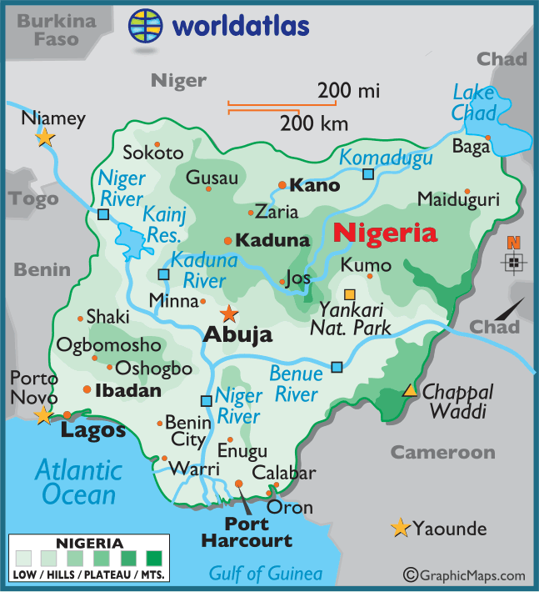
Case Study: Economic Development in Nigeria
Location & Importance
Nigeria is a NEE in West Africa. Nigeria is just north of the Equator and experiences a range of environments. Nigeria is the most populous and economically powerful country in Africa. Economic growth has been base on oil exports.
Influences upon Nigeria's development
Political | Social
Suffered instability with a civil war between 1967-1970. From 1999, the country became stable with free and fair elections. Stability has encouraged global investment from China and USA. | Nigeria is a multi-cultural, multi-faith society. Although mostly a strength, diversity has caused regional conflicts from groups such as the Boko Haram terrorists.
Cultural | Industrial Structures
Nigeria’s diversity has created rich and varied artistic culture. The country has a rich music, literacy and film industry (i.e. Nollywood). A successful national football side. | Once mainly based on agriculture, 50% of its economy is now manufacturing and services. A thriving manufacturing industry is increasing foreign investment and employment opportunities.
The role of TNCs | Changing Relationships
TNCs such as Shell have played an important role in its economy. + Investment has increased employment and income. - Profits move to HICs. - Many oil spills have damaged fragile environments. | Nigeria plays a leading role with the African Union and UN. Growing links with China with huge investment in infrastructure. Main import includes petrol from the EU, cars from Brazil and phones from China.
Environmental Impacts | Aid & Debt relief
The 2008/09 oil spills devastated swamps and its ecosystems. Industry has caused toxic chemicals to be discharged in open sewers - risking human health. 80% of forest have been cut down. This also increases CO² emissions. | + Receives $5billion per year in aid. + Aid groups (ActionAid) have improved health centres, provided anti-mosquito nets and helped to protect people against AIDS/HIV. - Some aid fails to reach the people who need it due to corruption.
Effects of Economic Development
Life expectancy has increased from 46 to 53 years. 64% have access to safe water. Typical schooling years has increased from 7 to 9.
“Evaluate to what extent, economic development has improved the quality of people’s lives in Nigeria”

