Slide 1
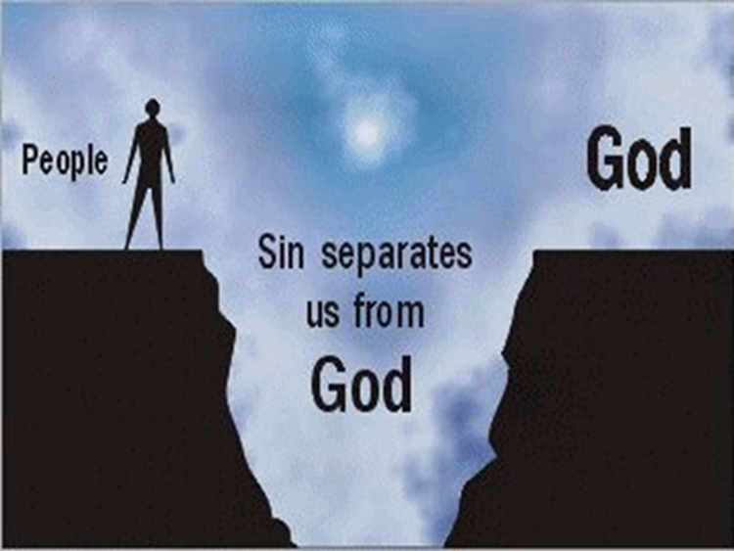
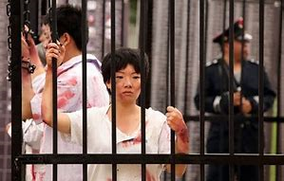
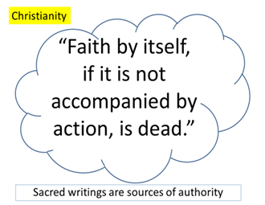
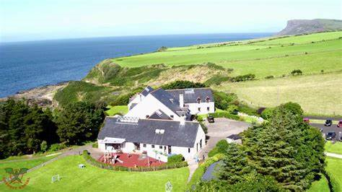
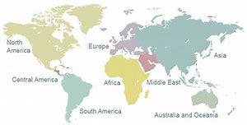
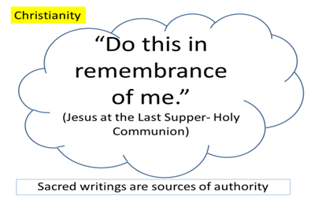
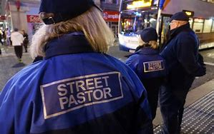
Key Vocabulary…
Picture This…
Always Remember…
Worship | Worship is the act of religious praise to give thanks to God and ask for forgiveness. It shows their love of God.
Public & private | Worship can be in public in a church with other Christians and it can also be in private on their own.
Liturgical | Worship which follows a set pattern each time, for example, prayers, Holy Communion, reading the Bible. Roman Catholic and Church of England worship in a liturgical way.
Non-liturgical | Worship which does not follow a set pattern each time, for example, not celebrating the Holy Communion at every service but spending more time reading the Bible. Methodist and Baptist churches worship in a non-liturgical way.
Spontaneous | Worship which follows no structure at all but is guided by the Holy Spirit: Quaker Christians sit in silence until someone feels moved to speak by the Holy Spirit.
Sacrament | A outward ceremony/sign of an inward, deep spiritual meaning. Holy Communion and baptism are sacraments. The bread & wine at Holy Communion mean the body & blood of Jesus’ sacrifice on the cross and the water of baptism symbolises the washing away of sin and welcoming a person into Christianity.
Transubstantiation | The belief Roman Catholic Christians have that the bread & wine at Holy Communion actually miraculously turns into the body & blood of Jesus’ sacrifice.
Pilgrimage | A religious and spiritual journey, for example, to Lourdes (France) and Iona (Scotland)
Mission | Mission is the calling to spread the faith. The church has a mission to tell people about the Son of God (Jesus) who came into he world to bring salvation. Jesus gave the disciples the Great Commission when he asked them to go out into the world to spread his teachings.
Evangelism | When a Christian spreads the faith by telling other about Jesus’ teachings.
Persecution | When areligious person is bullied and received bad treatment because of their religion, for example, not being able to build a church, being put in prison or even killed.
Atonement | Paying the price for sin
Reconciliation | Fixing a broken relationship, for example, when Jesus died on the cross he fixed the broken relationship between God and humans caused by sin. He atoned for human sin and gave salvation.
Electrical Components
. | Salvation Atonement Reconciliation | Fixing a broken relationship, for example, when Jesus died on the cross he fixed the broken relationship between God and humans caused by sin. He atoned for human sin and gave salvation.
 | Christian Aid | Christian Aid is a Christian charity which provides development aid and emergency aid to those in need. They donate money and pray for those who are in need and living in poverty.
 | Persecution | When areligious person is bullied and received bad treatment because of their religion, for example, not being able to build a church, being put in prison or even killed.
 | Corrymeela Community | In Northern Ireland – a centre to work for reconciliation .
 | Church growth | The church is growing rapidly in South America, Africa and Asia, but not in Europe, USA and Middle East
 | Street Pastors | Street Pastors are trained Christians who help the most vulnerable on the streets. They put agape (unconditional love) into practice.
Christians believe in one God who is understood in three parts or persons: God the Father, Jesus the son and the Holy Spirit. This is called the Trinity. The Trinity is active in a Christian’s life.
Tools & Equipment
Deeper Learning…
Create a connection map to show the role of the church in the local community and the world wide community.
Subject RE Year 10 Topic Christian Practices
Sacred writings
Activity – Plan your evaluation answer to 12 mark questions.
1. “The most important duty of a Christian is to worship God.” 2. The best way to understand God is to go on a pilgrimage.” 3. “Evangelism is wrong.” 4. “ Baptism is the most important sacrament.”

